Slide 1
GROUP 1 ELS 67

Slide 2
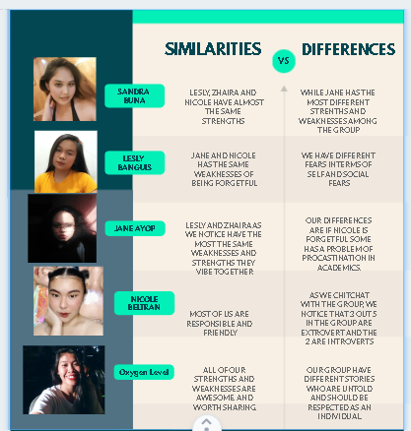
ZHAIRA DAGON

Slide 3
PROOF OF DISCUSSION
OUR GROUP DISCUSSED AND SHARE OUR STRENGTHS AND WEAKNESSES THROUGH MESSENGER CHATS BY SENDING OUR VENN DIAGRAM BECAUSE SOME ARE IN QUARANTINED AND SOME DON’T HAVE STABLE INTERNET CONNECTION

Slide 4
